Slide 1
Java Building Blocks
Classes, Interfaces, Objects, etc.

Slide 2
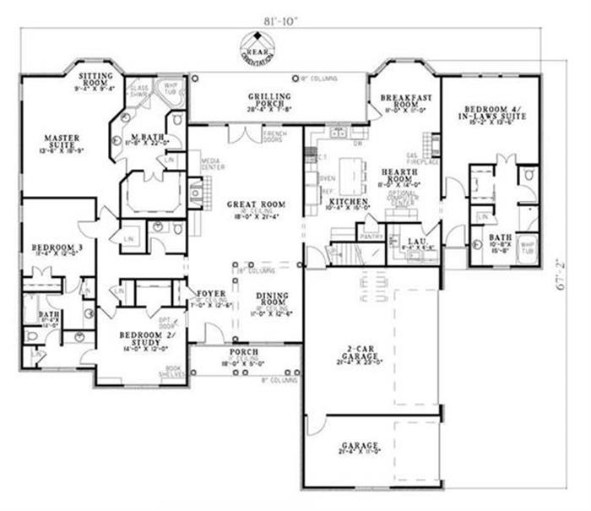
Class
A class is the blueprint
Each class exists only once in memory

Slide 3
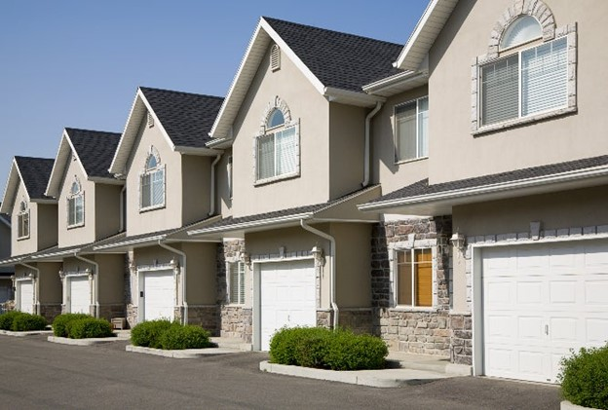
Objects (Instances)
Copy of the class
Initially the same (although they can be customized at creation time)
Each object has its own separate location in memory

Slide 4
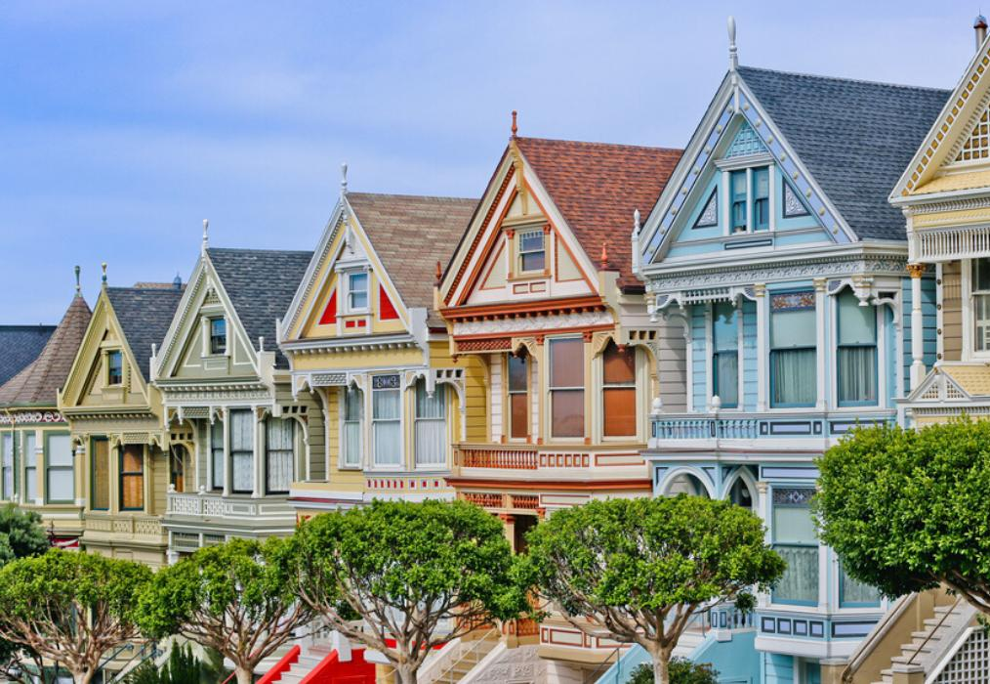
Objects (Instances)
Started out the same
Changed paint
Changed curtains
Changed trees
Each change only affects the individual object

Slide 5
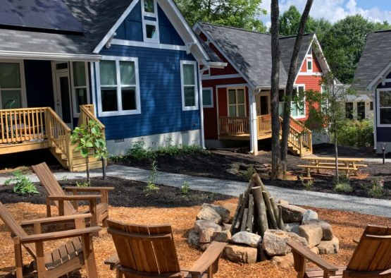
Static vs instance
Static is "outside" the home
Paint a chair, everyone sees it
Add a trashcan – it's available to all
Instance is "inside" the home
Change a rug, only one house has it
Static variables are stored in the class memory
Instance variables are stored in the instance memory
Add a bed – only one house gets it

Slide 6
Interface – a list of services

Slide 7
Interface
public interface HandyMan {
public void remodelHome();
public void carpentry();
public void drywallRepair();
public void repairSiding();
}

Slide 8
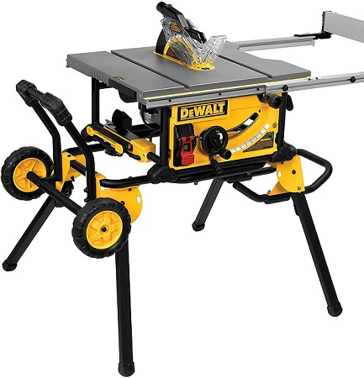
Interface
public class PowerBob
implements Handyman {
public void carpentry() {
usePowerTools();
}
}

Slide 9
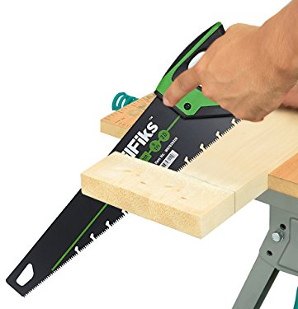
Interface
public class HandyBob
implements Handyman {
public void carpentry() {
useHandTools();
}
}

Slide 10

Interface
Defines the "what" but not the "how"
A contract of services provided

